Slide 1
Arrays
01
02
A Series of Elements
03

Slide 2
Content
01
Arrays
02
Operations
03
Iterating Arrays

Slide 3
01
Arrays
A series of elements

Slide 4
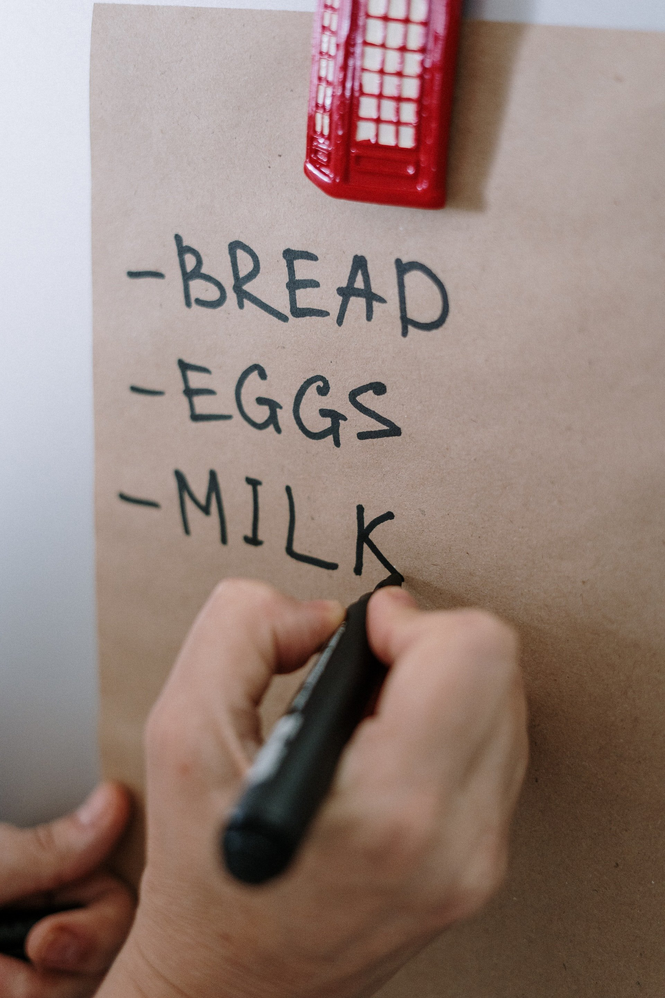
Arrays
TODO List -> collection of tasks;
Word -> collection of letters;
Sentence -> collection of words;

Slide 5
What is an array
An array is a sequence of elements
The elements in the array are numbered from 1 to length -1
Arrays in JS have variable length, unlike other languages ( C# , Java )
0
1
2
3
4
An array with 5 elements
Item index
…
…
…
…
…
Array element

Slide 6
Create an array
We use square brackets
Allocating an empty array :
Access by index
let numbers = [1, 2, 3, 4];
let names = [];
console.log(numbers[0]);
numbers[3] = numbers[1] + numbers[2];
console.log(numbers.length); // 5
console.log(numbers); // [1, 2, 3, 5, 5]

Slide 7
Working with arrays
Assigning a value to an element
Length indicates the count of elements in the array
Accessing an element by index
With the operator [ ] we access a specified element by index
for (let i = 0; i < numbers.length; i++)
numbers[i] = 1;
numbers[5] = 5;
numbers[6] = 6;

Slide 8
Day of the week
We can hold the days of the week in an array of strings
Write a function that accepts a number and prints the corresponding day of the week or " Invalid " if the number is invalid.
let days = [
"Monday" ,
"Tuesday" ,
"Wednesday" ,
"Thursday" ,
"Friday" ,
"Saturday" ,
"Sunday"
] ;

Slide 9
02
Operations
Built-in functions

Slide 10
Array printing
We use a for loop
We use array.join (separator)
let arr = [ 10 , 20 , 30 , 40 , 50 ];
for (let i = 0; i < arr.length; i++)
console.log(arr[i]);
let arr = [ 1, 2, 3 ];
console.log(arr.join(", ")); // 1, 2, 3

Slide 11
Print an array
Write a function that:
It initially accepts an array of integers
Prints each element on a separate line in reverse order
30
20
10
0
0
10
20
30
1
2
3
3
2
1

Slide 12
Round an array of numbers
Write a function that:
It initially accepts an array of real numbers
Prints any number rounded to the higher integer
0.5 -> 1
2.1 -> 3
4.3 -> 5
-0.5 -> 0
-2.1 -> -2
7.9 -> 8
0.5, 2.1, 4.3
-0.5, -2.1, 7.9

Slide 13
Exchange items
Write a function that:
Initially receives an array of real numbers
Reverses the order of the elements and prints the array
1 2 3 4 5 6
6 5 4 3 2 1
5 6 3 2 4
4 2 3 6 5

Slide 14
Exchange items - Solution
for (let i = 0; i < arr.length / 2; i++){
let oldElement = arr[i];
arr [i] = arr[arr.length - 1 - i];
arr [arr.length - 1 - i] = oldElement;
}
console.log(arr.join());

Slide 15
Array functions
push() – add to the end
pop() – remove from the end
unshift() – add to the beginning
shift() – remove from the beginning
includes() – look for value
indexOf () – find index of value

Slide 16
push() - add element
We create an empty array and add elements.
length is incremented with each addition
1
2
3
length:
0
10
arr
20
30

Slide 17
pop() - remove an element
We remove items from the list
length is decremented with each removal
2
length:
3
arr
10
20
30

Slide 18
unshift() - add element
Adding elements to the array
length is incremented with each addition
2
length:
3
5
arr
10
20

Slide 19
shift() - remove an element
We remove items from the list
length is decremented with each removal
2
length:
3
arr
5
10
20

Slide 20
0 3
For-of Loop
Traversing an array

Slide 21
for-of loop
Iterating through a collection
let arr = [ 1 , 2 , 3 ];
for( let element of arr ){
console.log( element );
};

Slide 22
Summary
An array - sequence of elements
Elements - from 0 to length-1
Accessing an element by index
Add, remove and insert elements
Traversing an array
Print an array

